Slide 1
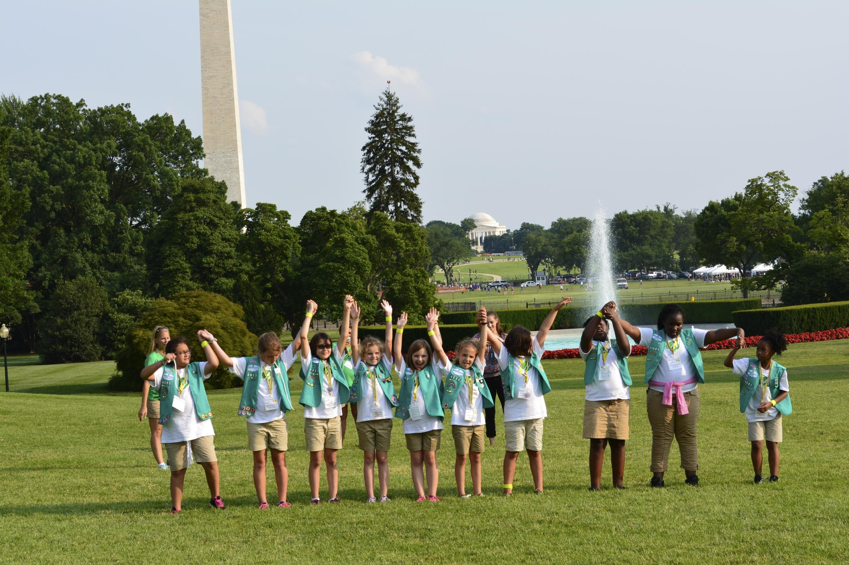
Girl Scout Bronze Award Training
Notes:
Ask- Have you ever looked around your neighborhood or school and wondered how you could make a change for the better?
This training will give you the chance to learn the steps to earning the Bronze Award and learn how earning the Bronze Award can help you make a positive change in your community.
Leaders, you will learn how to support your girls as they complete a Journey and create a take action project that improves their neighborhood or local community. Throughout the process you will use your experience and time to help the girls learn about themselves and the world around them, gain new skills, care about others, and overcome challenges.

Slide 2
Overview of the Bronze Award
Step One- Go on a Girl Scout Junior Journey
Step Two- Build your Girl Scout Bronze Award Team (3-5 girls) or decide to go solo
Step Three- Explore your community
Step Four- Choose a Girl Scout Bronze Award project
Step Five- Make a plan
Step Six- Put your plan in motion
Step Seven- Spread the word
Notes:
There are 7 steps to earning the Girl Scout Bronze Award.
Read over the steps.

Slide 3
Step 1- Go on a Junior Journey
Choose either:
  Agent of Change
  Get Moving!
  aMuse
Notes:
This step helps you build the skills you need to take on your award project and understand how to show leadership through the discover, connect, and take action keys.
Leaders encourage your girls to talk about what they have learned by completing a journey. Suggest they reflect and share where and how they applied the Girl Scout Promise and Law as they completed the Journey.
Keep your journey handy as you work toward your award – you might find yourself going back to it for ideas.

Slide 4
Once you have completed your Girl Scout Junior Journey it is suggested that the minimum number of hours for earning your Girl Scout Bronze Award is 20 hours.
Notes:
Remember you are committed to do your very best with every step
Each step wont require the same amount of hours
Plan your time in chunks and divide it up by the steps

Slide 5
Step 2 – Build your Girl Scout Bronze Award Team
Troop Model:
Your Girl Scout Junior Troop
Each girl must play an active role in choosing planning and developing the team’s Take Action Project
Partner with others in the community to complete your project
Solo Model:
Create and implement a project on your own
Partner with others in your community (friends, neighbors, and business owners) in order to earn your award
Notes:
Step 2- Build your Girl Scout Bronze Award Team. There are two options:
Option 1 is building a small team.
Keeping your team small ensures that everyone can participate fully
Members of the team must commit to respecting different points of view and ways of work, everyone helping out, accepting constructive suggestions, working together to create and develop a plan, and resolving conflicts that might occur
The second option is the Solo Model
This is where you create and implement a project on your own and partner with others in your community in order to earn your award.
Your leader will help you locate people in the community who might be able to help you with your project.

Slide 6
Step 3 – Explore Your Community
Now that you have begun to think about issues that concern you, it’s time to do some exploring to find out what your community needs are and where your areas of interest and the community overlap.
Notes:
Communities are groups of people who have something in common
Activity- “What are some of the communities you belong to?”
(Ex: school, church, town you live in, sports team, band…)

Slide 7
Now that you’ve listed your communities it’s time to map them:
A Community Map- is a drawing that shows the community’s needs and resources, including contacts who might help you when you start working on your Take Action Project
The key to making a good community map is observation
Notes:
Look for what people need: what will help improve their lives, help them out, make them happier
Visit places such as the library, town hall, community center, or place of worship where there are people and resources who can help you identify community needs
Attend a town meeting or two to find out what concerns people in your area

Slide 8
Getting started with your Community Map
Take a walk through your neighborhood, school, or town
Observe all the different aspects of your community while you shop at stores, gather at your Troop meeting place, or go to school
(Tip: go back to your Journey(s) for more ideas about spotting community needs)

Slide 9
Observation List
Observation What do you see and hear around you? Here are ideas for what to look out for. | Maybe We Could… Possible project ideas to make a difference
Our Girl Scout meeting space isn’t very “green,” and we’d also like to make the space more fun for younger Girl Scouts. | Add fun decorations that are also “green,” and figure out how much energy we use during our meetings.
Add your own… what else do you observe in the course of a day in your life?
Notes:
Use the Observation List found in your Guidebook to track information

Slide 10
Now it’s time to talk to people to get in-depth information about community issues.
Start by talking to people you know
  Neighbors or teachers
Ask them to introduce you to others in your community
  Business owners, school officials, religious leaders, council members, police officers, etc…
Notes:
Remember to prepare your questions ahead of time so you can use your interview time wisely

Slide 11
Always be safe when you talk to new people:
Discuss safety tips with your troop/group volunteer and family
Always go with a friend or team member
When going on line, take the Girl Scout Internet Safety Pledge at:
  www.girlscouts.org/internet_safety_pledge.asp
Never give out personal information on the internet

Slide 12
Community Contact List
Community Contact | Organization | Contact Information | How they can help
Notes:
Use the Community Contact List found in your packet to track information on people you meet or businesses that might be able to help you with your project
Leaders, throughout step 3 make sure that the girls are prepared and are being safe by making sure you know who they are meeting with and not going alone, that they are not giving out their personal information, and are fully prepared to interview perspective community partners
You might even consider doing some mock phone conversations and interviews.

Slide 13
Step 4 – Pick Your Take Action Project
You’ve come a long way to get to this point!!!

Slide 14
Whether you are working solo or on a team before you pick your project you will need to:
Review your Issues Chart, Observation Chart and Community Map
Choose a project based on what matters most to you or where you think you can create some positive change
(Tip: if you are having a hard time deciding, write a pro/con list for each choice)
Narrow your focus on one aspect of your issue if your issue is big and complicated it might be a good idea to
Remember you can always go back to your Journey(s) for project ideas and examples
Make sure everyone is clear about what you want to do and why if you are working with a team
Notes:
Leaders, encourage girls to:
Choose a project that is either bases on what matters most to them or based on where they think they can create the most positive change
Be realistic based on their available time and resources

Slide 15
Issues Chart
Issues that concern you | Why is it important to you? | How does this issue effect your community?
Notes:
This issues chart can help you make the connection between what you care about and the issues in your community
Use the Issues Chart in your Guidebook to help you brainstorm
You are not picking your project yet, just coming up with topics you care about
Your leader will create an open, comfortable environment where you can share your thoughts and ideas

Slide 16
Answer the following:
What is my/our project?
Why does it matter?
Who will help?

Slide 17
Think about the following:
Which of your leadership skills do you think you’ll use as work on your Take Action Project?
How will these skills help you better understand who you are and what you can do?
How will you live the Girl Scout Promise and Law while earning your Girl Scout Bronze Award?

Slide 18
Step 5 – Make a Plan
Now that you’ve chosen a project, it’s time to make a plan!!!

Slide 19
Before You Start:
What steps do we need to take to reach our goal?
What special talents can each girl use to make the project a success?
What did we learn when we earned our Girl Scout Junior journey awards that will help us make sure this project runs smoothly?
Do we know enough to get started or do we need more background information? Where can we get that information?
Which groups or organizations can we work with? Who can we ask for help?
How can we get other people involved?
What supplies will we need?
How will we earn money for our project, if necessary?
How much time do we need to finish our project? Is that timeline realistic?
Notes:
Go through the following questions to help you think through your project before you start
Read slide
In reference to earning money your troop leader can help you come up with money earning ideas that follow Safety Wise and Council guidelines. As a general rule girls don’t aske for money or donations in Girl Scouting.

Slide 20
Make It Last:
You’ll be investing a lot of time on your Take Action Project, so you’ll want to develop it in a way that it keeps going even after you’re gone!!!
(Tip: a simple, clear, focused, and well thought out plan can often be more SUSTAINABLE than taking on a huge project)
Notes:
What does sustainable mean?
What would the difference between a service project and a take action project be?

Slide 21
Sustainable Projects last after your involvement ends, is long lasting or continuous; not a “one shot” deal:
Take Action Projects
Address the root (main) cause of an issue
Create long term impacts (lasting results) that can be measured by the number of people helped, the number of people involved, or the reduction in the community need
Include provisions to ensure sustainability long after you have finished the project
  Creates a lasting change
  Is NOT a one time event
Community Service Projects
Address an immediate need in the community by making the community better for some people, at that moment
Address the issue for only a short period of time
Does not include provisions to ensure that the service is long lasting or continuous
  Organizing a book or clothing drive
  Painting walls to cover up graffiti
  Holding a one-time march or fair to highlight a community

Slide 22
Two examples of SUSTAINABLE Take Action Projects:

Slide 23
T.A.P. #1
Problem: Kids can’t walk to school safely because there aren’t any sidewalks.
Root Cause: Lack of planning when the roads were built.
Solution with long-term impact: Create a petition asking that a sidewalk be built, get local residents to sign it, and present it to the city council.
Making the Solution Sustainable:
  Once the sidewalk is built, it will be in place for years, offering a safe route for future generations.
  You may need to encourage kids to change their habits and walk – that can be a fun group activity.

Slide 24
T.A.P. #2
Problem: Children in homeless shelters often struggle in school.
Root Cause: Lack of stability and family resources, both financial and emotional.
What could be a solution with long-term impacts?
How could you make the solution sustainable?

Slide 25
T.A.P. #2 Possible Answers
Solution with long-term impact: Work with a local homeless shelter and school to establish an ongoing tutoring program that matches student volunteers with children in the shelter.
Making the solution sustainable:
Work with the school and shelter to find adult staff members who will continue to coordinate the program.
Establish a transition tradition, such as an end-of-school-year party, where potential new student volunteers can meet current volunteers and people in the homeless shelter.

Slide 26
Find a Project Advisor:
Your project advisor is an expert who can answer specific questions about your issue.
(Tip: look at your list of the people you met while researching issues)
Notes:
In Step 5 you also what to find your Project Advisor

Slide 27
Make a Global Connection:
Think about others who may have worked on the same problem in the past, or check the Internet to see how others around the globe deal with your issue.
Notes:
Making a global connection can help you:
Learn to solve an issue using a different approach
Extend your project beyond your community or
Share your plan with other communities who are facing the same issues

Slide 28
Take One Last Look:
Take a step back and look at your project one more time
Do you need to narrow your focus a bit more or shift your approach in order to make the project work?
Ask others for feedback, especially your troop/group volunteer
(Tip: remember to be open to new ideas and suggestions, you may need to rethink certain parts of your project.)
Notes:
By this point you are probably anxious to get started, but before you do…

Slide 29
Step 6 – Put Your Plan Into Motion
It’s time to get started!!!

Slide 30
Your project needs to involve action by you and your Bronze Award Team (if you have one), from the planning stages all the way to earning the Girl Scout Bronze Award.
Build a list of what you’ll need to do, how it can be done, and who will be doing what (remember you are a team and one or more girls can volunteer for each task), and when each task needs to be finished.

Slide 31
Make a plan chart:
What is the Task? | Who will do it? | How will the task be done? | When will it be done?
Research how a petition is presented to the city council | Monique | Talk to a council member or the mayor | September 7
Notes:
Use this Make A Plan Chart to help you keep up with all your information.

Slide 32
When your steps are identified and your plan is set…
DO IT!
Remember to keep a record as you go by taking photos, shooting video, or making a scrapbook. This will help make it easier to share your story when you are through.
Your project must be completed no later than September 30th (Fall) of your 6th grade year.
Notes:
Leaders, be sure to let the girls take the lead to plan and implement their project. They miss out on all the leadership and skill building opportunities when adults take the lead or do the work for them.

Slide 33
Step 7 – Spread the Word
Congratulations, you have earned the highest award for a Girl Scout Junior – the Girl Scout Bronze Award!!!

Slide 34
Reflect:
Take the time to reflect on all of your hard work.
What did you discover about yourself?
What did you learn from others who worked to solve the same problem?
What skills did you gain?
What impact did your T.A.P. have on your community? How will it go on past your involvement?
How did you live the Girl Scout Promise and Law?
Notes:
Leaders, guide your girls through the reflection process. It is an important step. It helps them develop critical thinking skills and a true understanding of the impact of their project and how it relates to others in the community.

Slide 35
Share Your Story:
Create a Website or blog about what you have learned and how your project will help your community.
Log on to some web sites where you can share your story:
  World Association of Girl Guides and Girl Scouts: www.wagggs.org/en/projects
    Taking if Global: www.tigweb.org
Do a presentation for a younger group of Girl Scouts
Notes:
Any other ideas for sharing your story?

Slide 36
Notify Council of your Achievement
Fill out the Recognition Request Form
After the notification form has been returned to Council you will receive a congratulatory letter from the Council CEO.
Your leader will receive on your behalf, a certificate of achievement which is to be presented to you at your troop or service unit Court of Awards, special meeting, or celebratory event.
Your leader may also choose to have the certificate presented at the council’s annual council-wide recognitions ceremony.

Slide 37
Annual Council Higher Awards Recognitions
Girl Scouts Heart of the South will hold a council-wide recognition event each year for higher award recognitions.
Troops who wish to be recognized during the event must submit their Recognition Request Form by March 31st. This deadline has no affect on local Troop or Service Unit spring recognition deadlines and is put in place in order to prepare materials and presentations for the council-wide recognitions.
Troops that haven’t completed their projects by March 31st will be recognized during the council recognitions the following year.
Absolute Final deadline to earn the Bronze Award is September 30th (fall) of your 6th grade year.

Slide 38
Remember to thank all the people who helped you along the way, from the people you interviewed to those that drove you around town! They’ll be proud to know they helped make it happen.
Notes:
How can you show appreciation to those who helped you along the way?

Slide 39
Questions?
Contact your Higher Awards Council Liaison:
Jenny Jones - jenny.jones@girlscoutshs.org or 662-350-6041

